Slide 1
Status Report #21
2020. 04. 03 (Fri)
B4 FUJIWARA Tomomasa

Slide 2
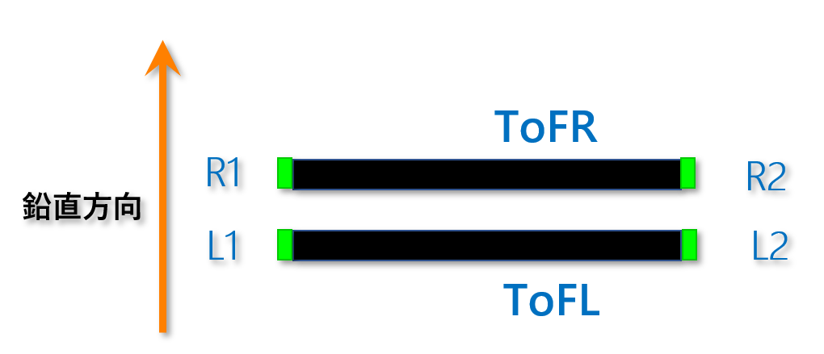
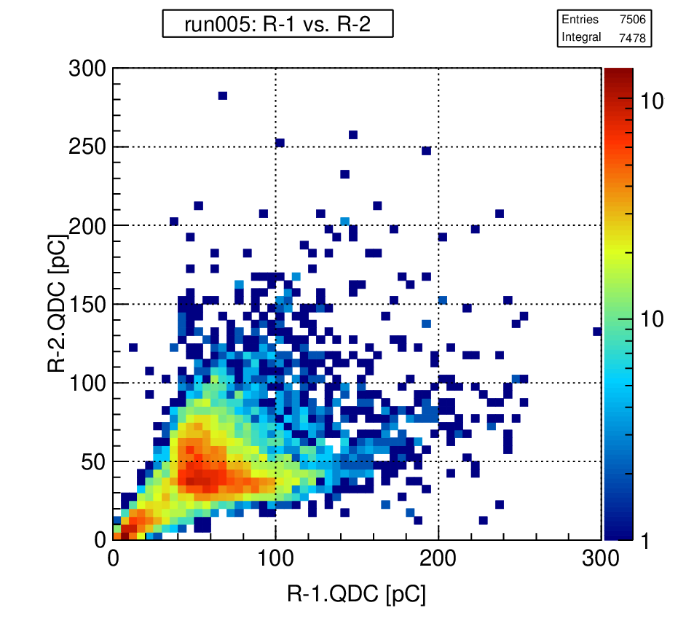
Timing resolution vs. QDC
Checked Timing resolution vs. MIP
How to decide MIP of each scintillator
2
Uneven for both side
Evaluate geometric average of both MPPC
⇒ define “MIP” of the detector

Slide 3
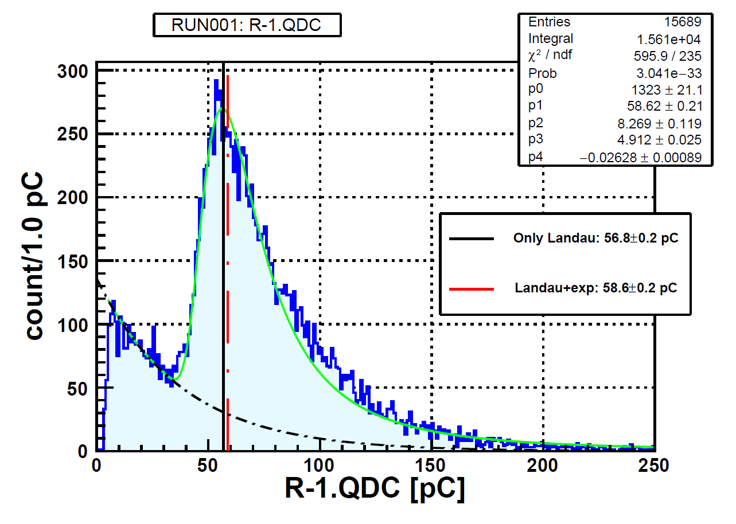
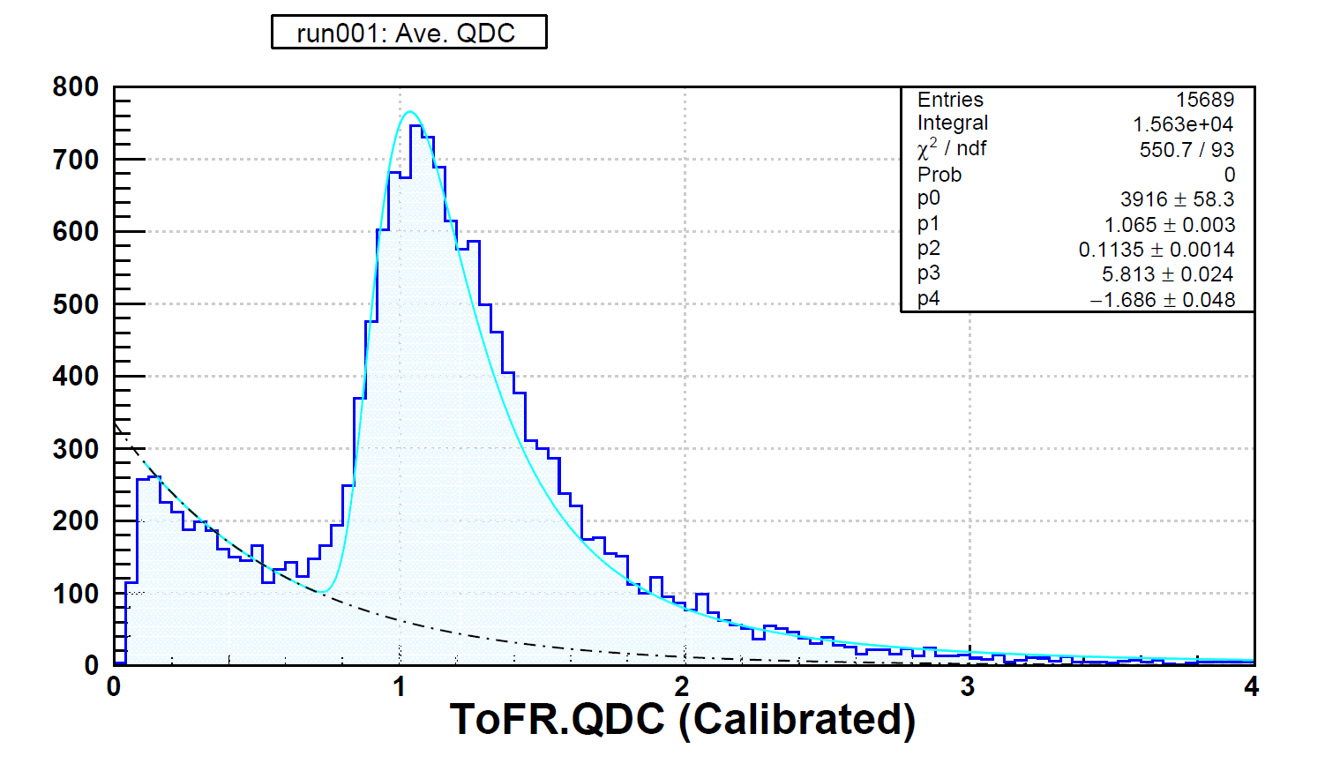
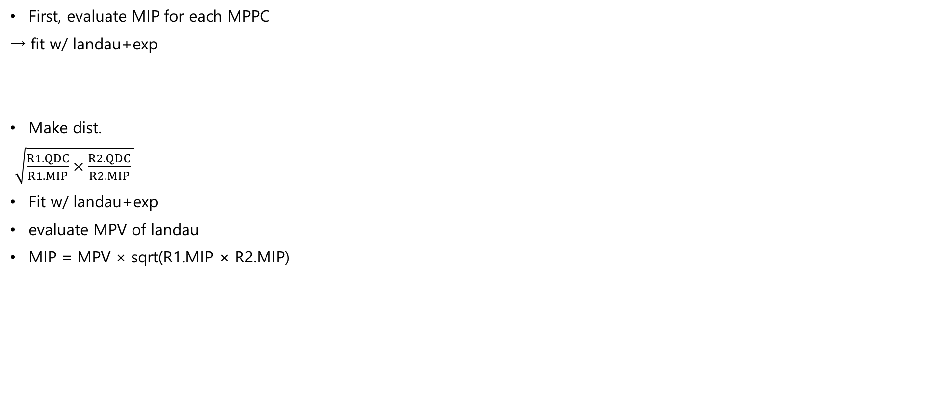
Decide MIP for scintillator
First, evaluate MIP for each MPPC
→ fit w/ landau+exp
Make dist.
$\sqrt{\frac{R1.QDC}{R1.MIP}×\frac{R2.QDC}{R2.MIP} }$
Fit w/ landau+exp
evaluate MPV of landau
MIP = MPV × sqrt(R1.MIP × R2.MIP)

Slide 4
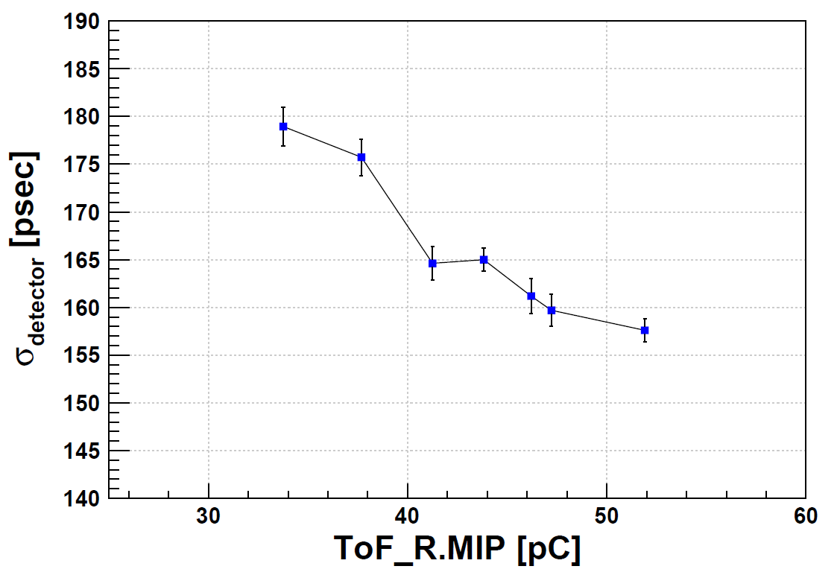
Timing resolution vs. MIP (1) -from cable length dep.-
σ_{detector} vs. MIP of ToFR
Error: only statistic by fitting
Slightly improve with increasing MIP value

Slide 5
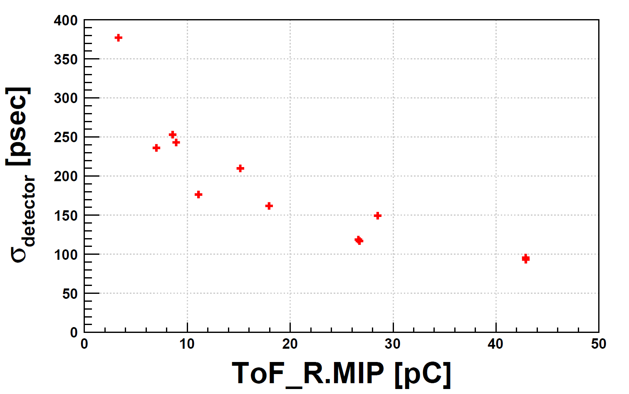
Timing resolution vs. MIP (2) –thickness & width dep.-
5^{t} × 11^{w} & 5^{t} × 22^{w} & 5^{t} × 44^{w} mm²
V_{b} – V_{op} = 0.0, +3.0, +6.0 V

Slide 6
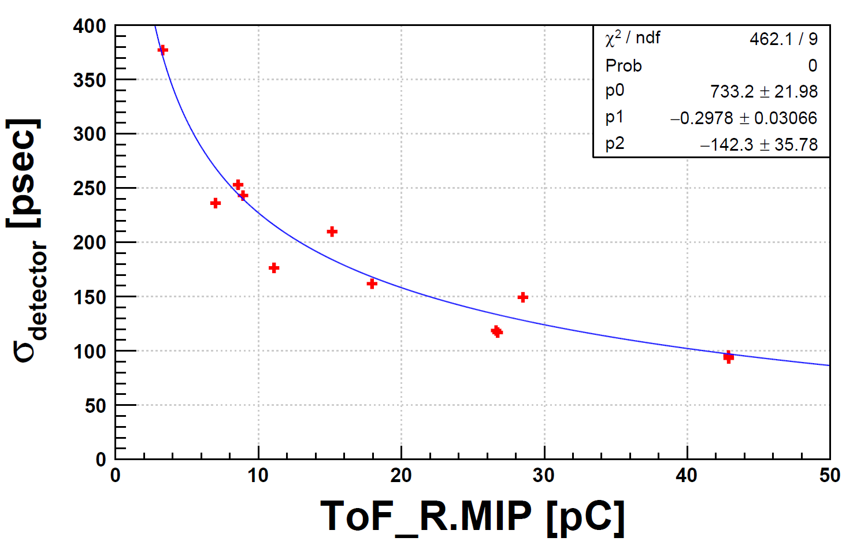
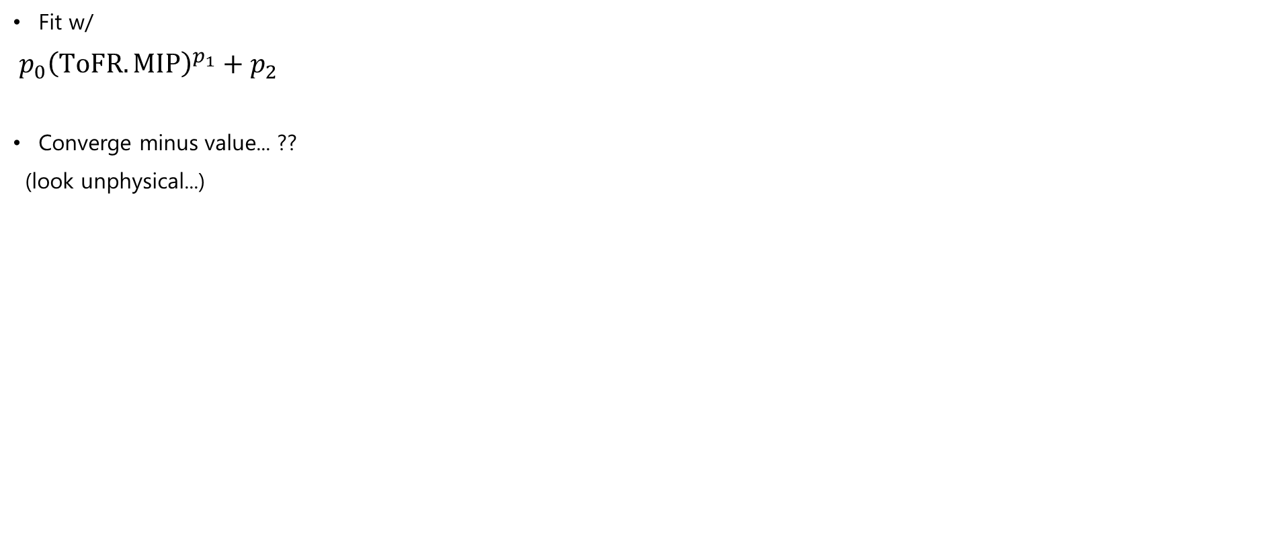
Fit w/
$p_{0}{\left(ToFR.MIP\right)}^{p_{1}}+p_{2}$
Converge minus value... ??
(look unphysical...)

Slide 7
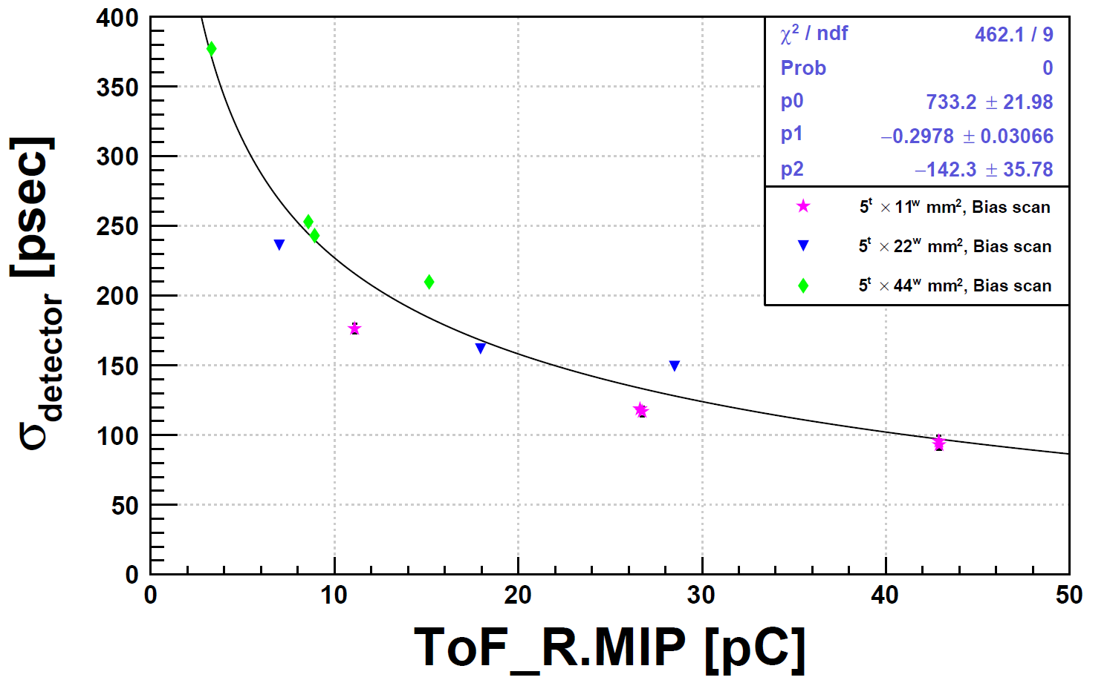
display to separate for each conditions
Look like to follow different function
It might have to deal individually ?

Slide 8
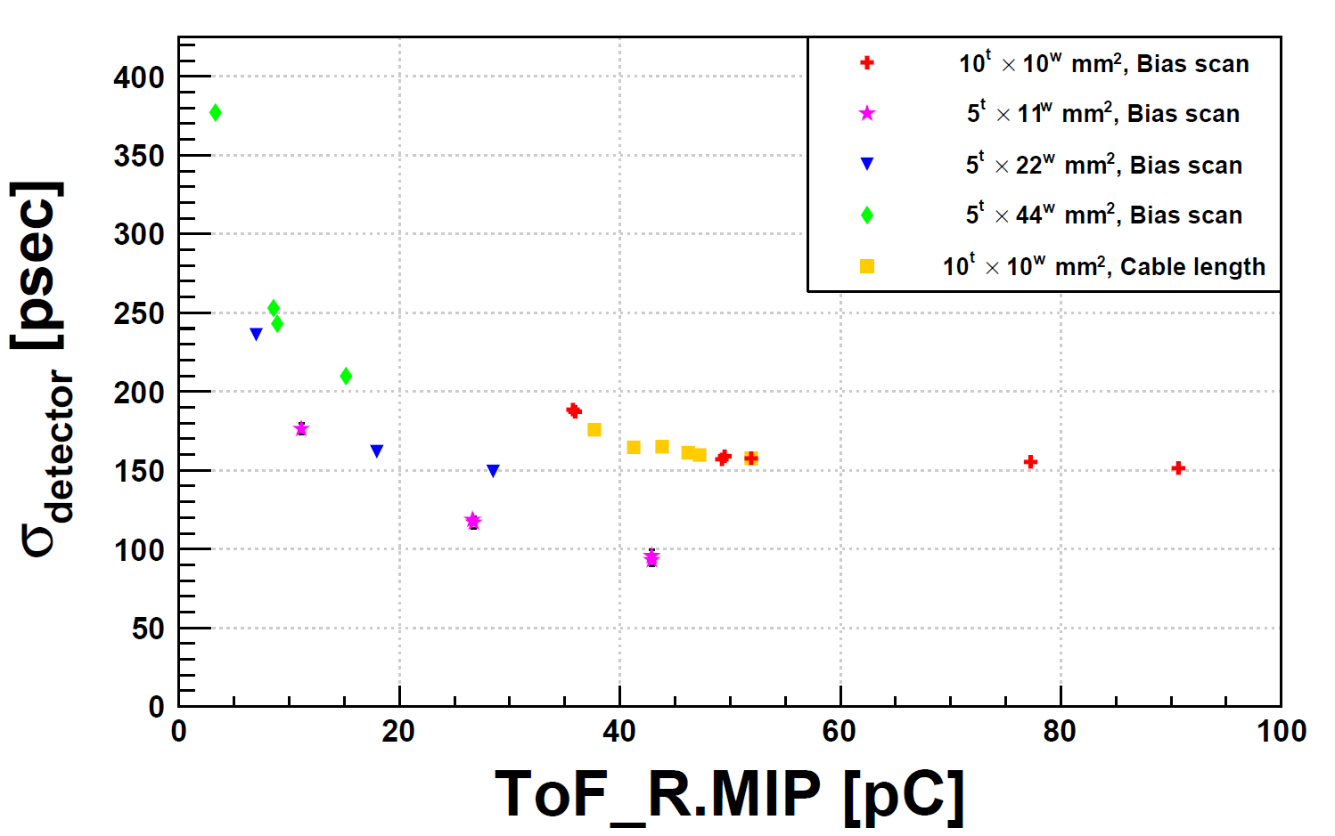

Slide 9
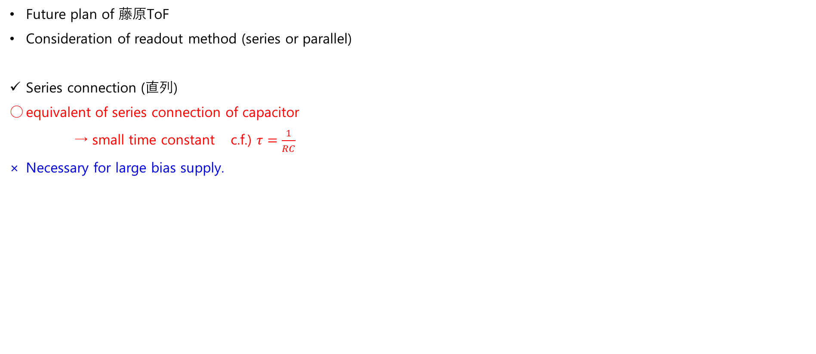
New MPPC board
Future plan of 藤原ToF
Consideration of readout method (series or parallel)
Series connection (直列)
equivalent of series connection of capacitor
→ small time constant c.f.) $τ=\frac{1}{RC}$
Necessary for large bias supply.
Parallel connection (並列)
Small bias supply
Large time constant

Slide 10
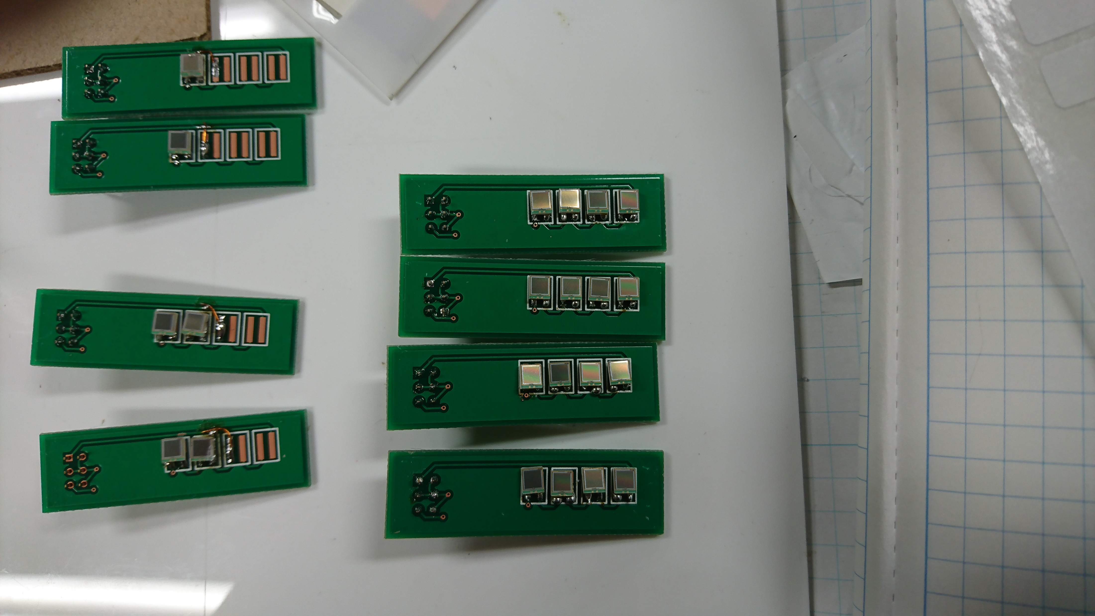
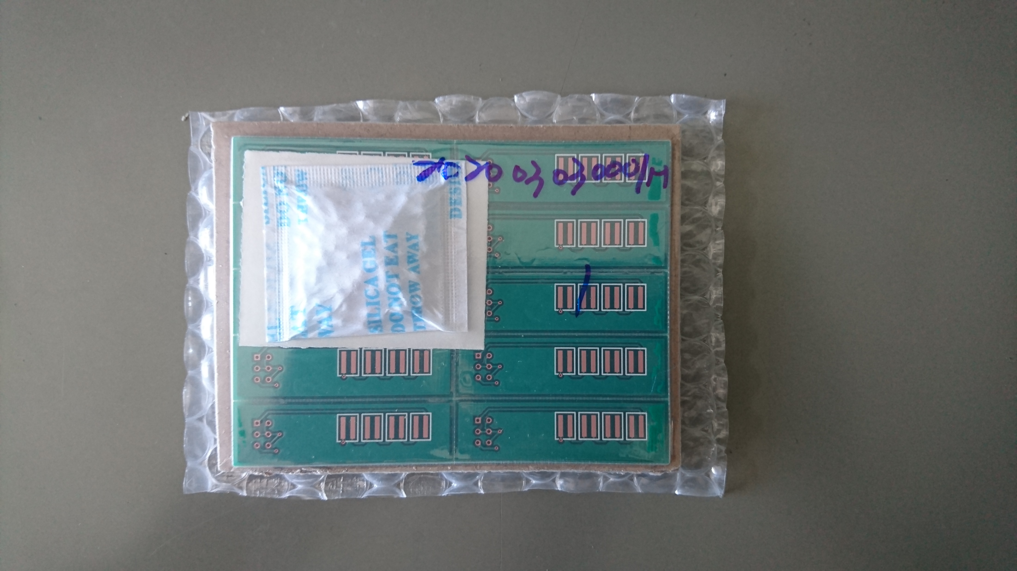
New MPPC board
Soldering MPPC, resister etc.
Thank you so much Toyama-san

Slide 11
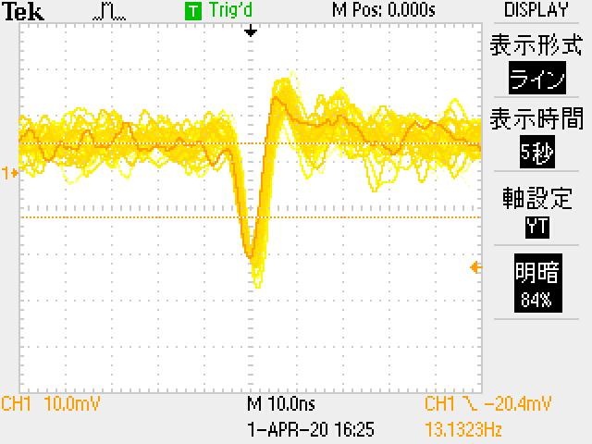
Performance check
4MPPCs on board
At V_{b} = 196.0 V (~ 48 V 相当?)
Shading light w/ black sheet
10.0 nsec
10.0 mV
Power supply
for OP amp
Bias supply
for MPPCs
PM amp

Slide 12
To do next
New board
Install testbench & data taking.
Analysis of cosmic-lay data
Consideration for charge & size dependence
Write B4 thesis.

Slide 13
Back up

Slide 14
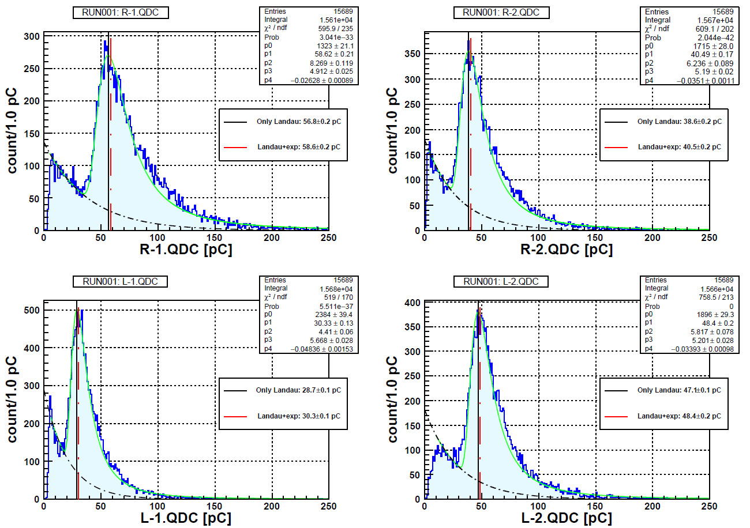

Slide 15
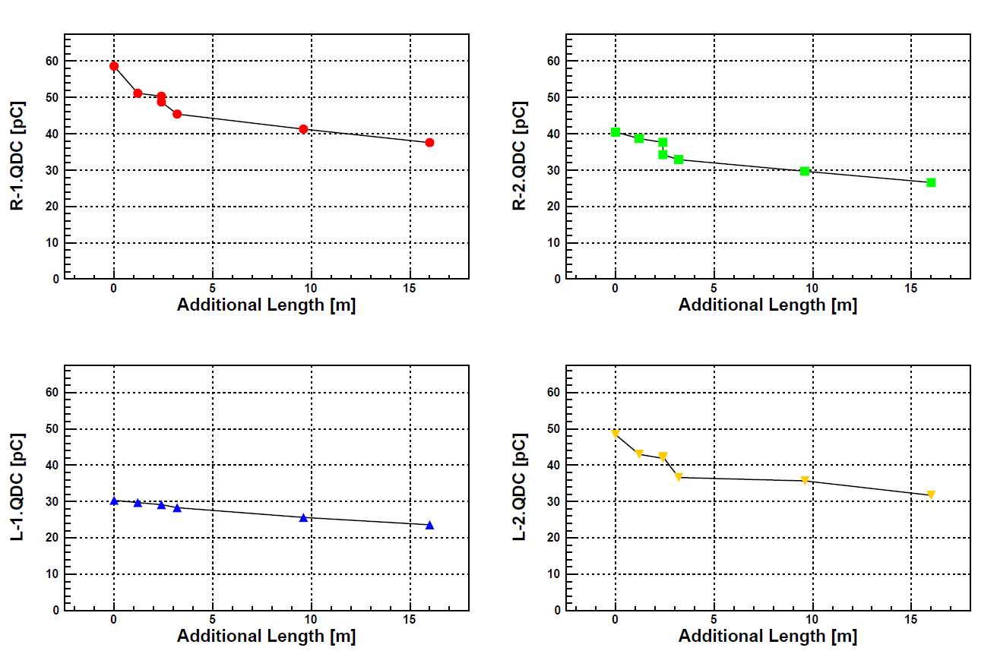

Slide 16
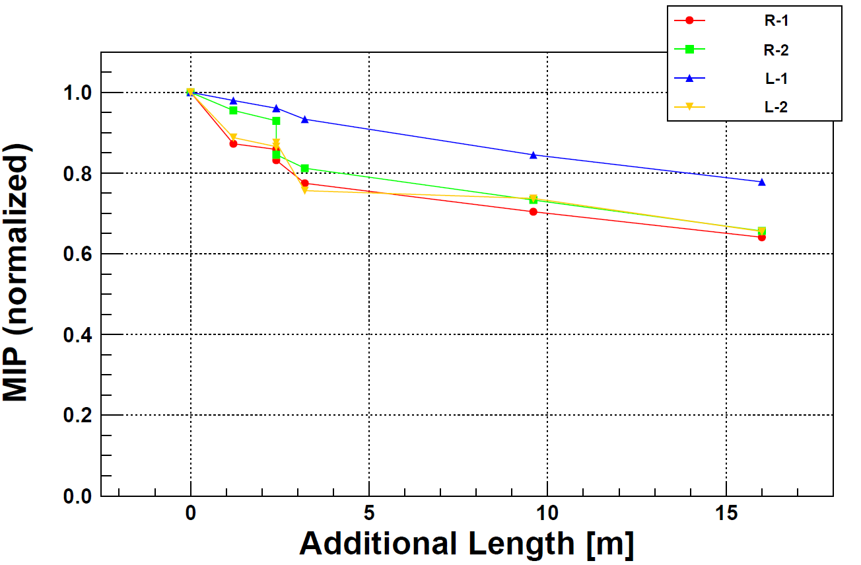

Slide 17
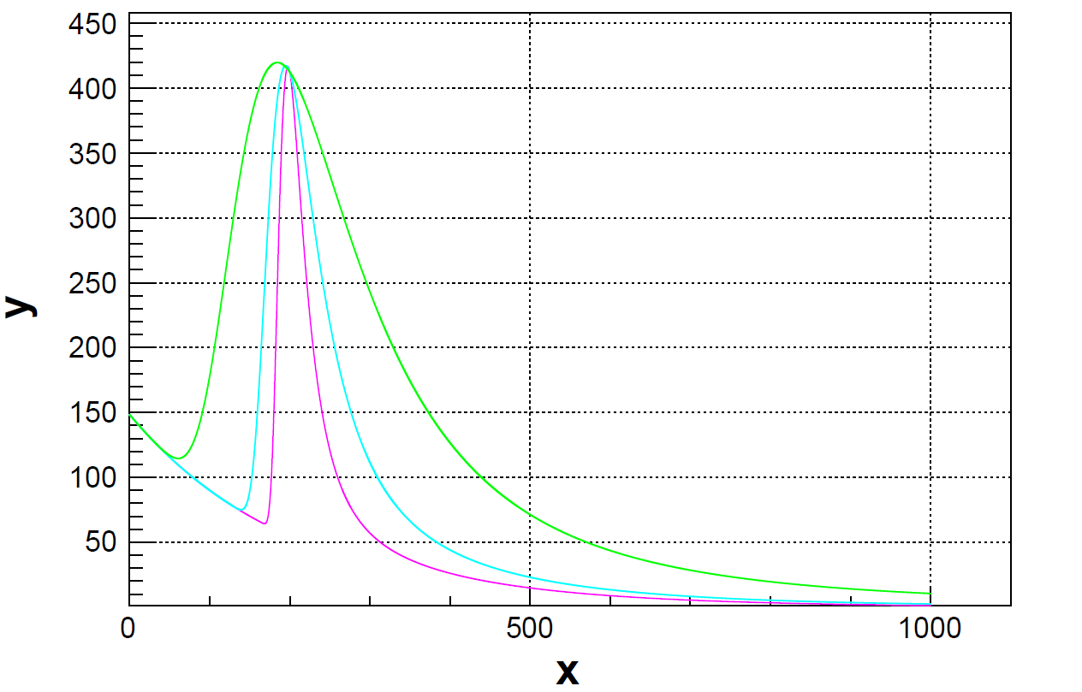
―
Landau.Const = 2000.
Landau.MPV = 200.
Landau.Sigma = 50.
Exp.Const = 5.
Exp.Slope = -0.005
―
Landau.Const = 2000.
Landau.MPV = 200.
Landau.Sigma = 10.
Exp.Const = 5.
Exp.Slope = -0.005
―
Landau.Const = 2000.
Landau.MPV = 200.
Landau.Sigma = 20.
Exp.Const = 5.
Exp.Slope = -0.005

Slide 18
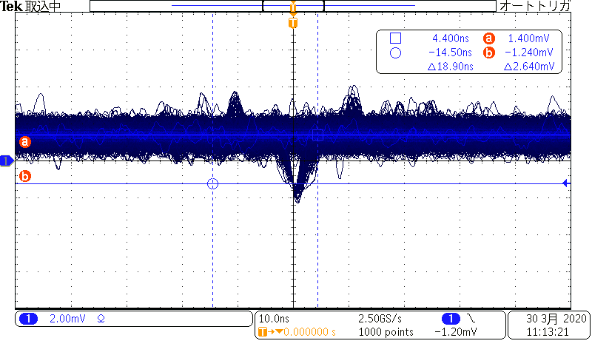

Slide 20
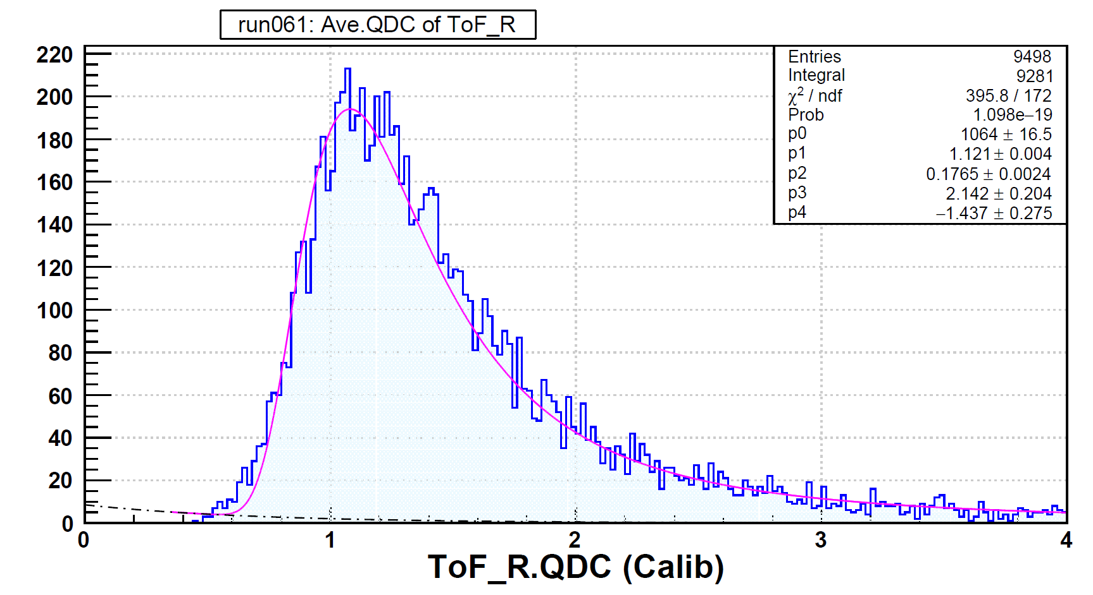

Slide 23
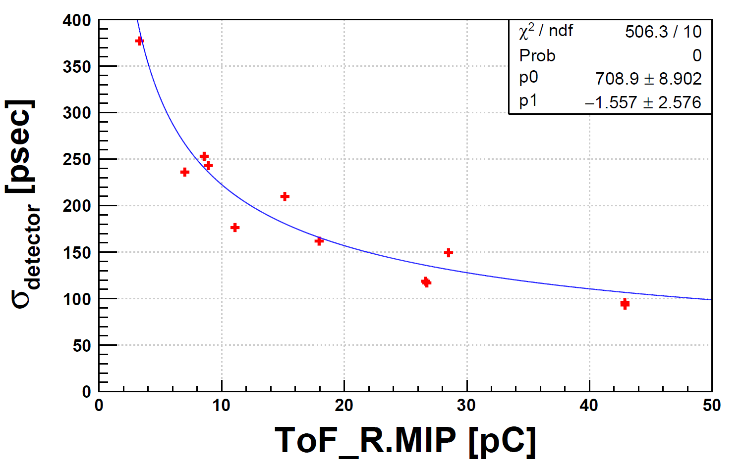

Slide 24
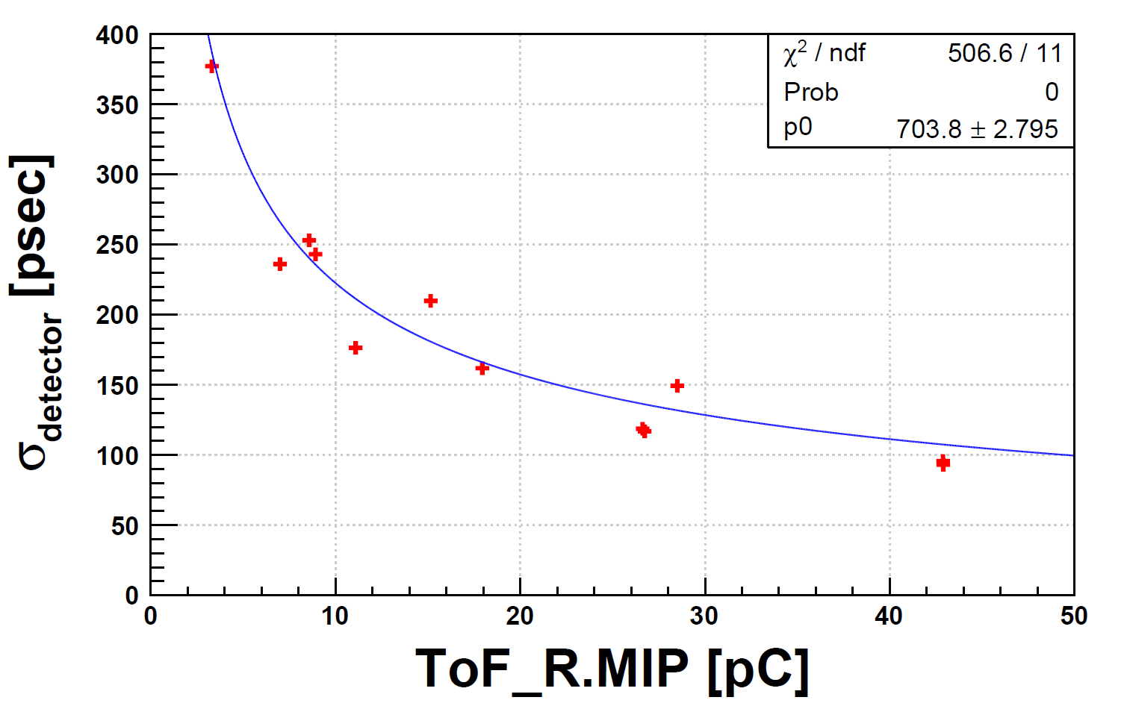

Slide 28
